Slide 1
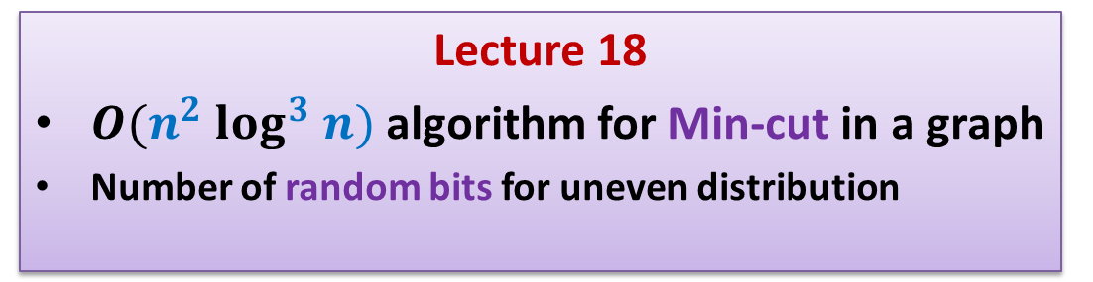
Randomized Algorithms CS648
Lecture 18
$O(n^{2} log^{3} n)$algorithm for Min-cut in a graph
Number of random bits for uneven distribution

Slide 2
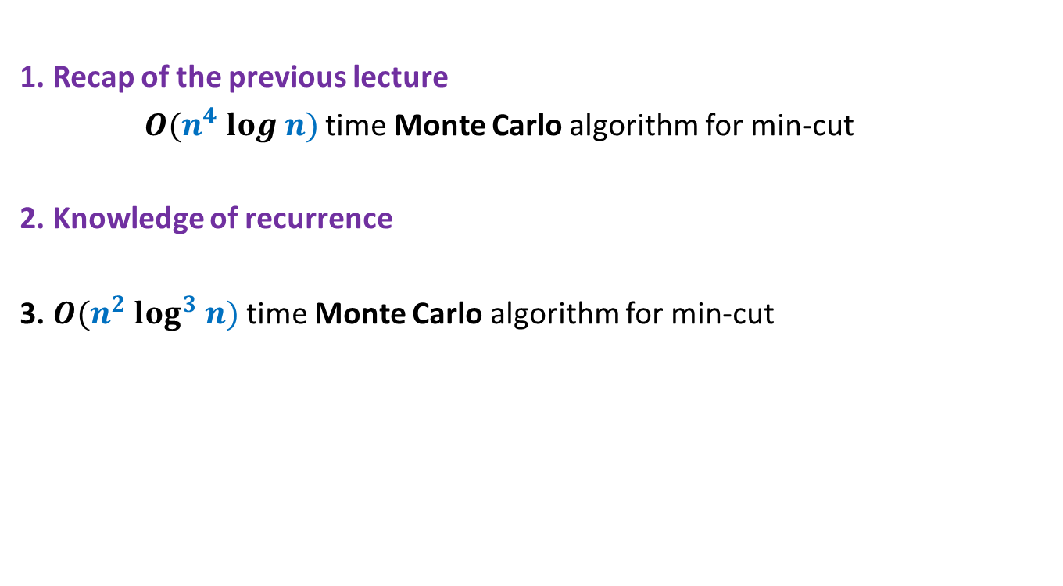
Overview
1. Recap of the previous lecture
$O(n^{4} log n)$time Monte Carlo algorithm for min-cut
2. Knowledge of recurrence
3. $O(n^{2} log^{3} n)$time Monte Carlo algorithm for min-cut
To analyse time complexity of an algorithm
To design efficient algorithm
There are so many lessons that you can learn from today’s lecture… ☺

Slide 3
Recap of the previous lecture
Min-cut

Slide 4

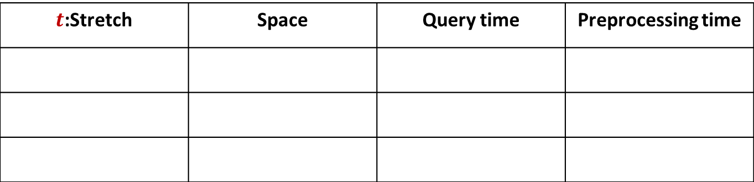






Graph and Multi-graph
$$u$$
$$a$$
$$l$$
$$v$$
$$x$$
$$b$$
$$h$$
$$w$$

Slide 5



Min-Cut
$G=(V,E)$: undirected connected graph
Definition (cut):
A subset $C⊆E$whose removal disconnects the graph.
Definition (min-cut): A cut of smallest size.
Problem Definition: Design algorithm to compute min-cut of a given graph.
$$u$$
Observation : If size of min-cut is $k$, then $m≥\frac{nk}{2}$?

Slide 6



















Contract($G,e$)
$$u$$
$$x$$
$$a$$
$$l$$
$$v$$
$$y$$
$$b$$
$$h$$
$$w$$
Contract($G,(x,y))$
$$u$$
$$a$$
$$l$$
$$v$$
$$xy$$
$$b$$
$$h$$
$$w$$

Slide 7
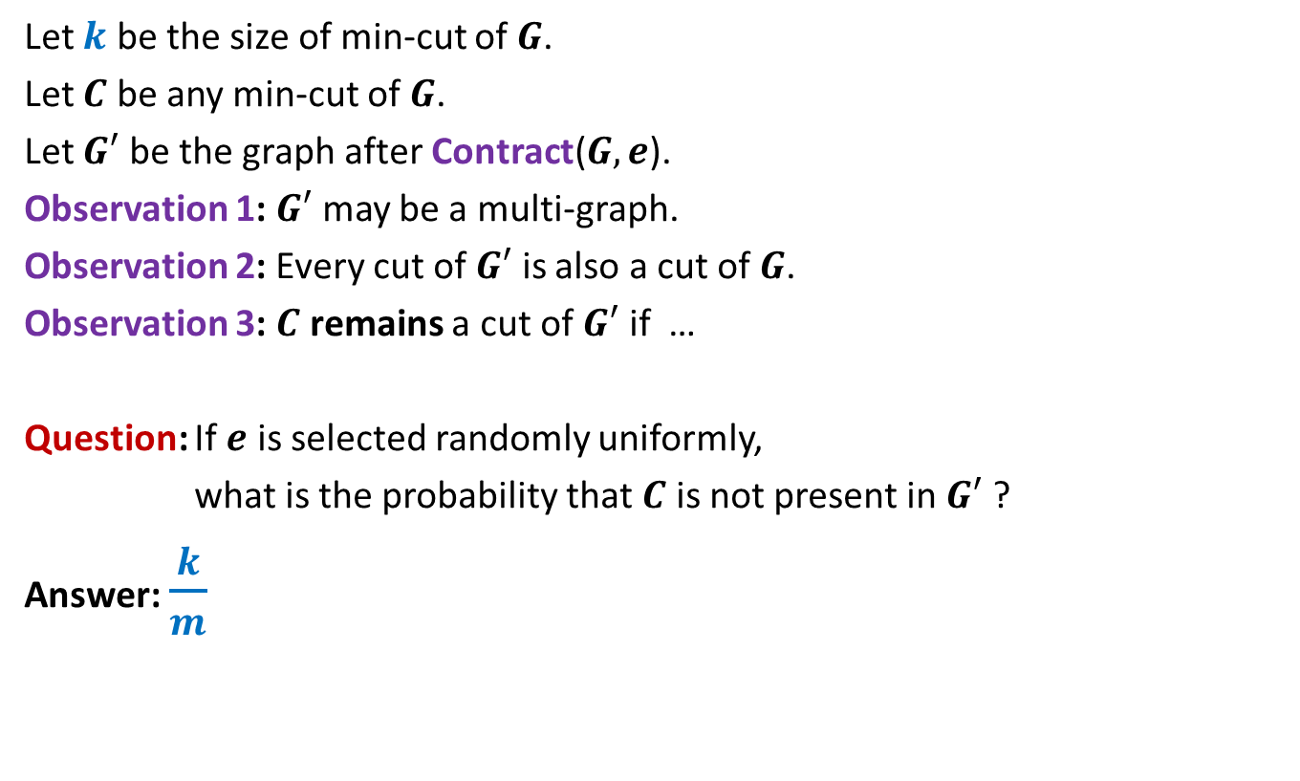


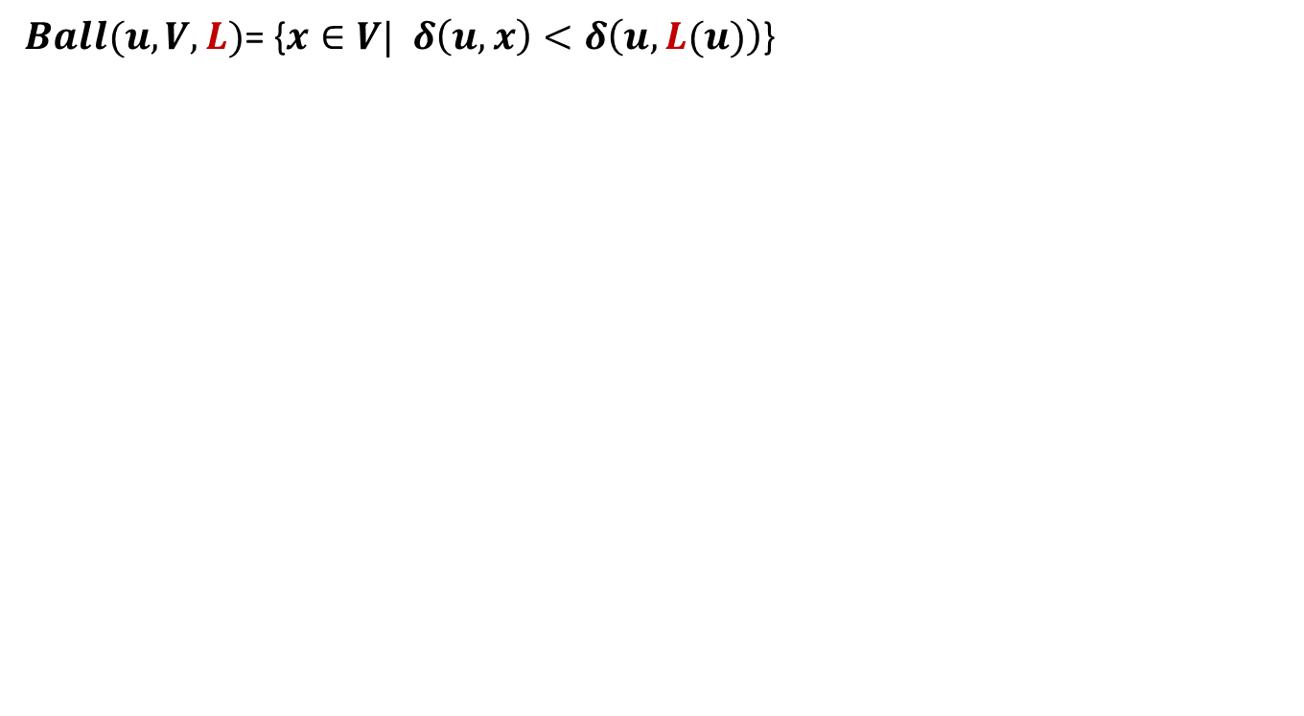
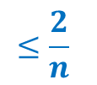
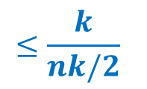
Observations about Contract($G,e$)
Let $k$ be the size of min-cut of $G$.
Let $C$ be any min-cut of $G$.
Let $G′$ be the graph after Contract($G,e$).
Observation 1: $G′$ may be a multi-graph.
Observation 2: Every cut of $G′$ is also a cut of $G$.
Observation 3: $C$ remains a cut of $G′$ if …
Question: If $e$ is selected randomly uniformly,
what is the probability that $C$ is not present in $G′$ ?
Answer: $\frac{k}{m}$
$e∉C$.
$$≤\frac{k}{nk/2}$$
$$≤\frac{2}{n}$$
Recall that $m≥\frac{nk}{2}$

Slide 8
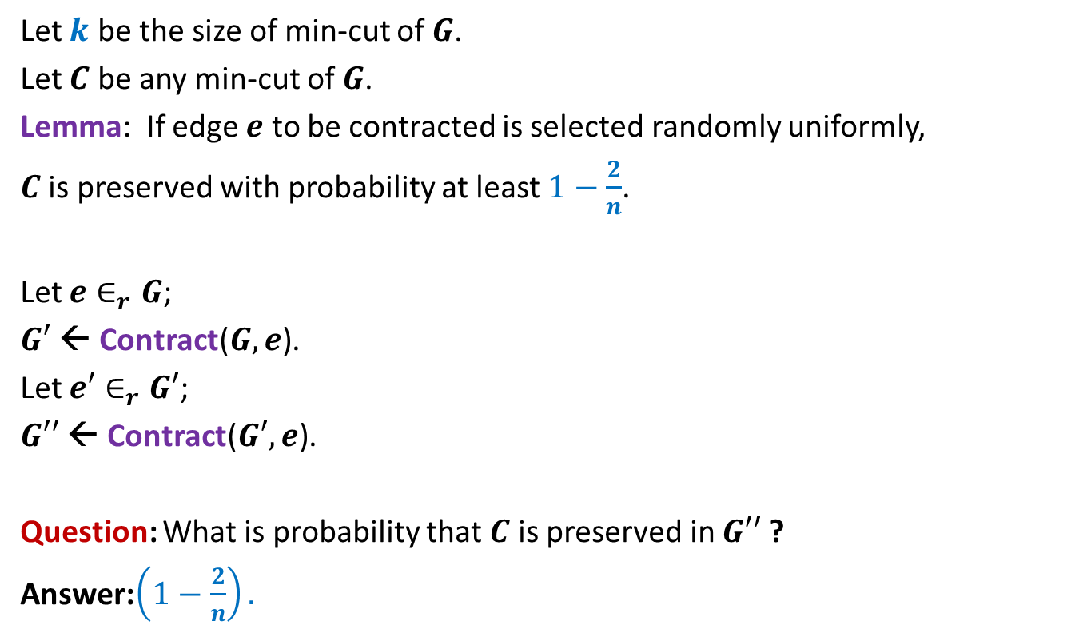
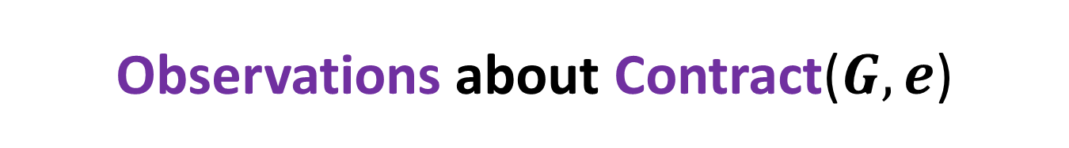

Observations about Contract($G,e$)
Let $k$ be the size of min-cut of $G$.
Let $C$ be any min-cut of $G$.
Lemma: If edge $e$ to be contracted is selected randomly uniformly,
$C$ is preserved with probability at least $1−\frac{2}{n}$.
Let $e∈_{r}G$;
$G′$ ← Contract($G,e$).
Let $e′∈_{r}G′$;
$G′′$ ← Contract($G′,e$).
Question: What is probability that $C$ is preserved in $G′′$ ?
Answer:$\left(1−\frac{2}{n}\right).$
$$\left(1−\frac{2}{n−1}\right)$$

Slide 9


Algorithm for min-cut
Min-cut($G$):
{ Repeat ?? times
{
Let $e∈_{r}G$;
$G$ ← Contract($G,e$).
}
return the edges of multi-graph $G$;
}
Running time: $O(n^{2})$
$$n−2$$

Slide 10
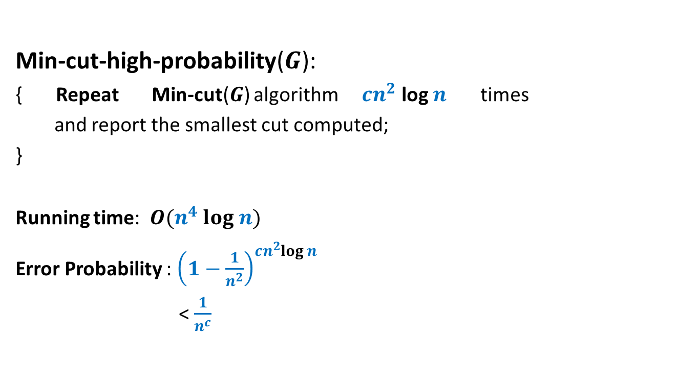
Algorithm for min-cut
Min-cut-high-probability($G$):
{ Repeat Min-cut($G$) algorithm $cn^{2}$ log $n$ times
and report the smallest cut computed;
}
Running time: $O(n^{4} log n)$
Error Probability : ${\left(1−\frac{1}{n^{2}}\right)}^{cn^{2}log n}$
< $\frac{1}{n^{c}}$

Slide 11






Algorithm for min-cut
Min-cut($G$):
{ Repeat ?? times
{
Let $e∈_{r}G$;
$G$ ← Contract($G,e$).
}
return the edges of multi-graph $G$;
}
Running time: $O(n^{2})$
$$n−2$$
$n_{i}$:
no. of vertices in the beginning of $i$th iteration
$O(n$) time
$O(n_{i}$) time

Slide 12
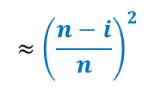
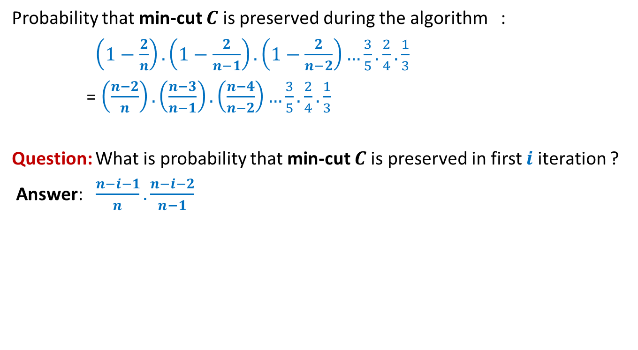
Algorithm for min-cut
Probability that min-cut $C$ is preserved during the algorithm :
$\left(1−\frac{2}{n}\right).\left(1−\frac{2}{n−1}\right).\left(1−\frac{2}{n−2}\right)…\frac{3}{5}.\frac{2}{4}.\frac{1}{3}$
= $\left(\frac{n−2}{n}\right).\left(\frac{n−3}{n−1}\right).\left(\frac{n−4}{n−2}\right)…\frac{3}{5}.\frac{2}{4}.\frac{1}{3}$
Question: What is probability that min-cut $C$is preserved in first $i$ iteration ?
Answer: $\frac{n−i−1}{n}.\frac{n−i−2}{n−1}$
$$≈{\left(\frac{n−i}{n}\right)}^{2}$$

Slide 13


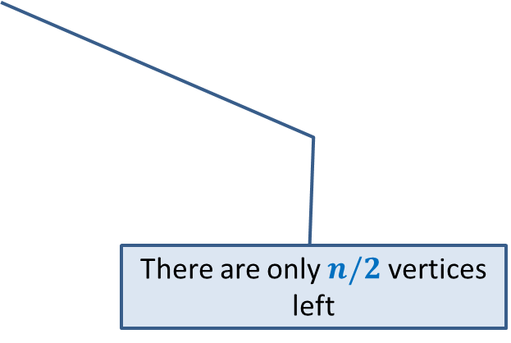
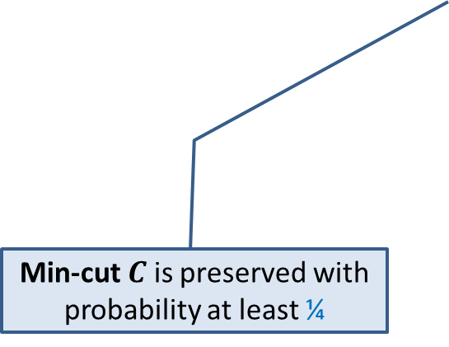
Key observations about Min-Cut algorithm
Algorithm performs $n−2$ contractions :
$$n/2$$
Min-cut $C$ is preserved with probability at least ¼
There are only $n/2$ vertices left

Slide 14
Revisiting Recurrences
In the following slides, we shall revisit common recurrences. Try to solve these recurrences in a simple manner instead of using Master’s theorem. This will help you develop a useful insight into recurrences. This insight will help you fine-tune the previous inefficient algorithm and eventually lead to design (and analysis) of a more efficient algorithm for min-cut.

Slide 15
Revisiting Recurrences

Slide 16

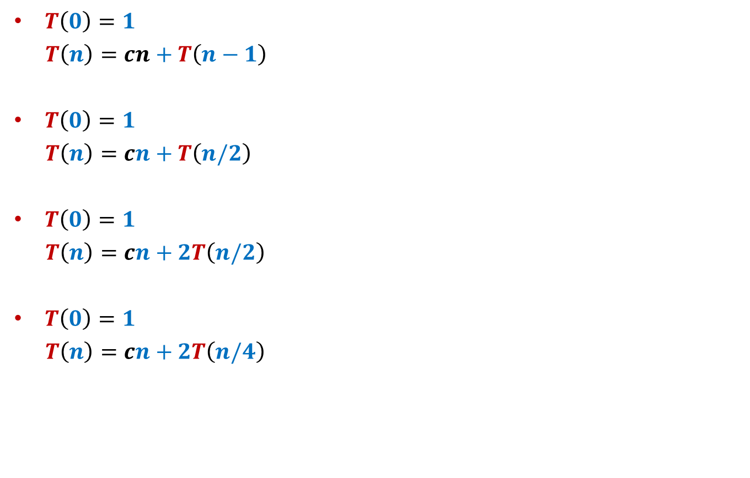



Common recurrences
$T\left(0\right)=1$
$T\left(n\right)=cn+T\left(n−1\right)$
$T\left(0\right)=1$
$T\left(n\right)=cn+T\left(n/2\right)$
$T\left(0\right)=1$
$T\left(n\right)=cn+2T\left(n/2\right)$
$T\left(0\right)=1$
$T\left(n\right)=cn+2T\left(n/4\right)$
$$O(n^{2})$$
$$O(n)$$
$$O(n log n)$$
$$O(n )$$

Slide 17


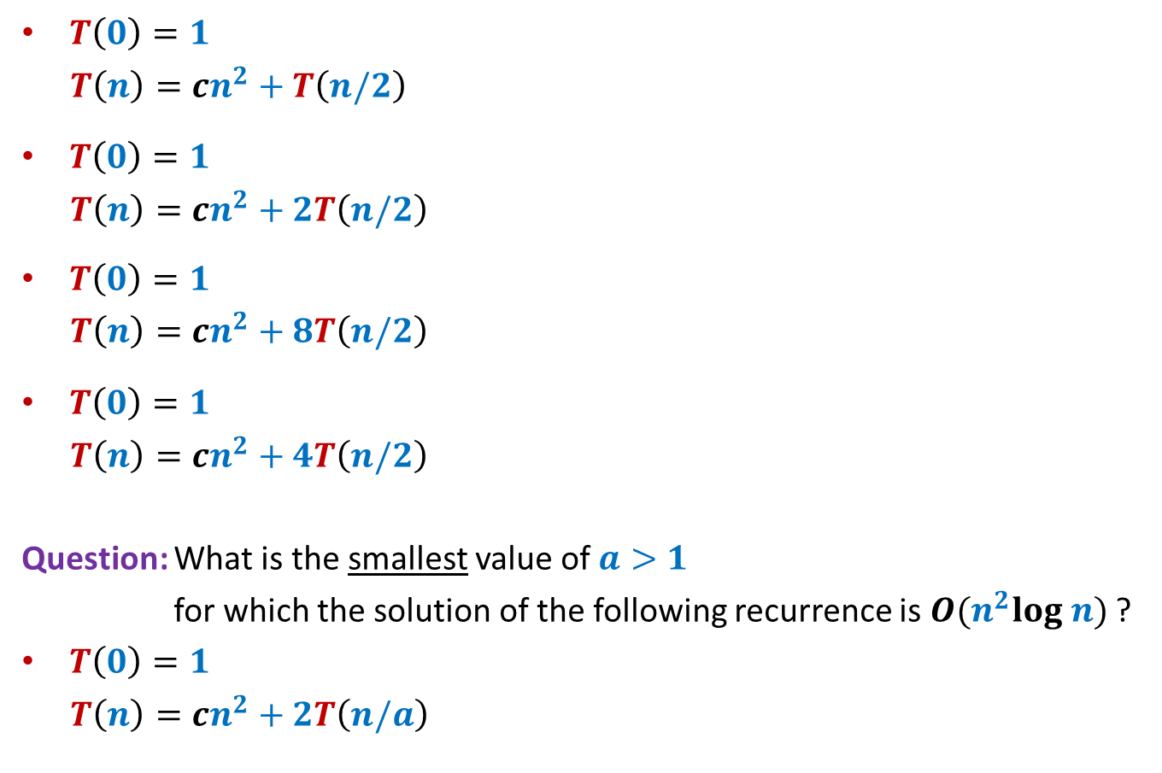



Common recurrences
$T\left(0\right)=1$
$T\left(n\right)=cn^{2}+T\left(n/2\right)$
$T\left(0\right)=1$
$T\left(n\right)=cn^{2}+2T\left(n/2\right)$
$T\left(0\right)=1$
$T\left(n\right)=cn^{2}+8T\left(n/2\right)$
$T\left(0\right)=1$
$T\left(n\right)=cn^{2}+4T\left(n/2\right)$
Question: What is the smallest value of $a>1$
for which the solution of the following recurrence is $O(n^{2}log n)$ ?
$T\left(0\right)=1$
$T\left(n\right)=cn^{2}+2T\left(n/a\right)$
$$O(n^{2})$$
$$O(n^{2})$$
$$O(n^{3})$$
$$O(n^{2} log n)$$
$$a=√2$$
Closer $a$ gets to $1$, the farther $T\left(n\right)$ gets from $n^{2}$

Slide 18
Faster Min-cut algorithm

Slide 19
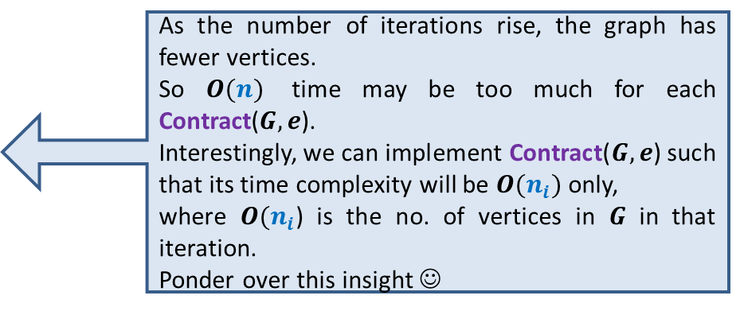
Revisiting algorithm for min-cut
Min-cut($G$):
{ Repeat ?? times
{
Let $e∈_{r}G$;
$G$ ← Contract($G,e$).
}
return the edges of multi-graph $G$;
}
Running time: $O(n^{2})$
$$n−2$$
As the number of iterations rise, the graph has fewer vertices.
So $O(n)$ time may be too much for each Contract($G,e$).
Interestingly, we can implement Contract($G,e$) such that its time complexity will be $O(n_{i})$ only,
where $O(n_{i}$) is the no. of vertices in $G$ in that iteration.
Ponder over this insight ☺
We shall modify this algorithm to improve its success probability.
But we shall not allow any significant blow up in the running time.

Slide 20
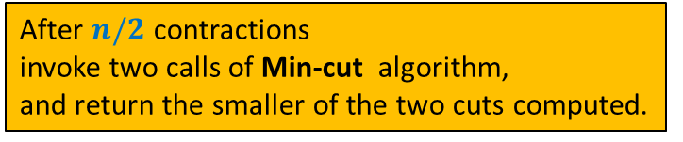
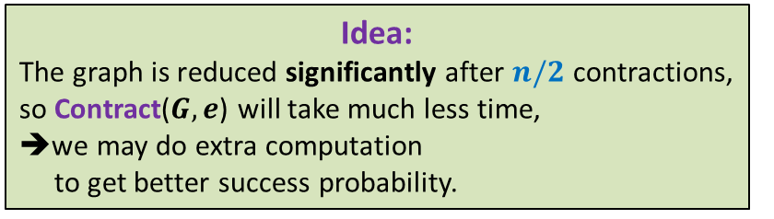
Key observations about Min-Cut algorithm
Algorithm performs $n−2$ contractions :
$$n/2$$
Min-cut $C$ is preserved with probability at least ¼
There are only $n/2$ vertices left
Idea:
The graph is reduced significantly after $n/2$ contractions,
so Contract($G,e$) will take much less time,
➔we may do extra computation
to get better success probability.
How to materialize this idea ?
After $n/2$ contractions
invoke two calls of Min-cut algorithm,
and return the smaller of the two cuts computed.
recursively

Slide 21



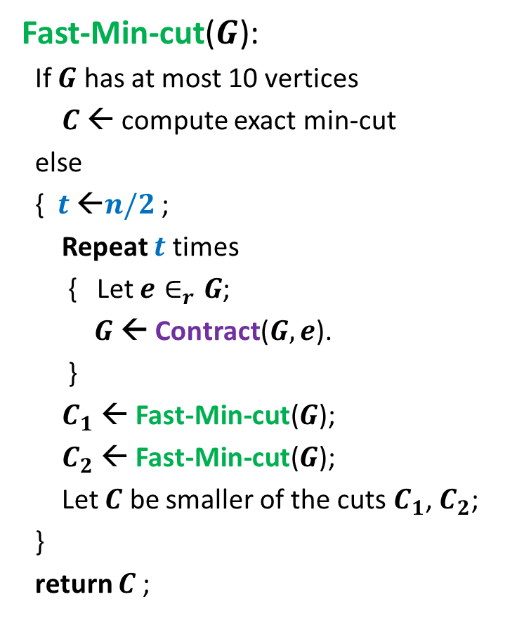



Revised algorithm for min-cut
Time complexity
Fast-Min-cut($G$):
If $G$ has at most 10 vertices
$C$ ← compute exact min-cut
else
{ $t$ ←$n/2$ ;
Repeat $t$ times
{ Let $e∈_{r}G$;
$G$ ← Contract($G,e$).
}
$C_{1}$ ← Fast-Min-cut($G$);
$C_{2}$ ← Fast-Min-cut($G$);
Let $C$ be smaller of the cuts $C_{1}$, $C_{2}$;
}
return $C$;
$T\left(n\right)=1$ for $n≤10$
$T\left(n\right)=cn^{2}+2T\left(n/2\right)$
Question: What is the smallest value of $t$
to ensure $T\left(n\right)=O(n^{2}log n)$ ?
$$n−t)$$
How to increase this prob. even further ?
reduce $t$.
Prob. the min-cut is preserved till here = ?
1/4
$n−t=$ $n/√2$
➔ $t=$ $n−n/√2$

Slide 22
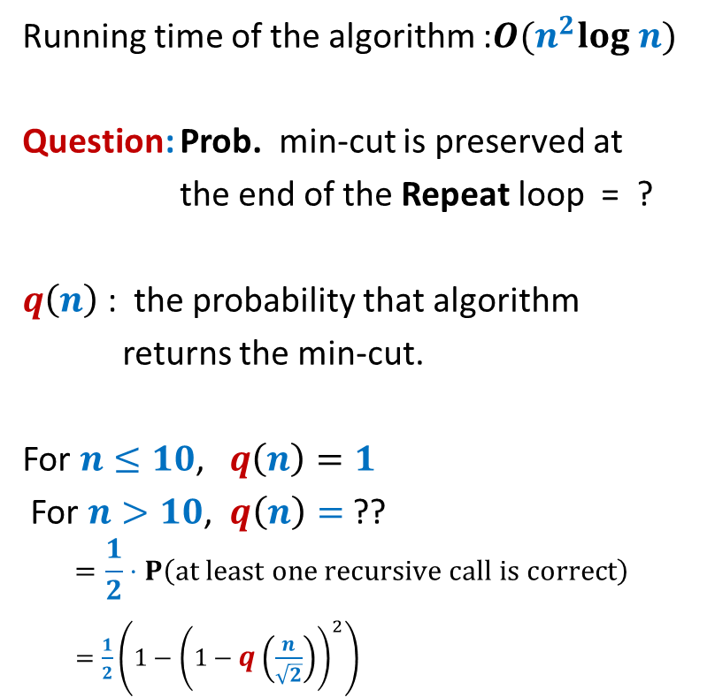
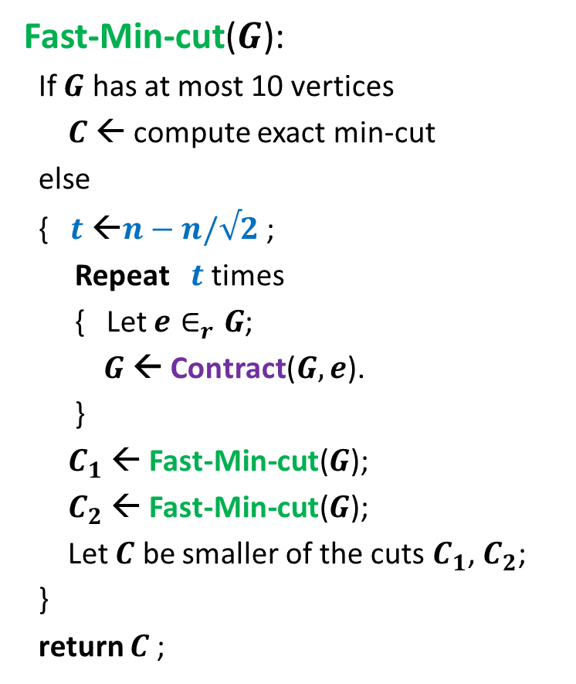

Faster algorithm for min-cut
Fast-Min-cut($G$):
If $G$ has at most 10 vertices
$C$ ← compute exact min-cut
else
{ $t$ ←$n−n/√2$ ;
Repeat $t$ times
{ Let $e∈_{r}G$;
$G$ ← Contract($G,e$).
}
$C_{1}$ ← Fast-Min-cut($G$);
$C_{2}$ ← Fast-Min-cut($G$);
Let $C$ be smaller of the cuts $C_{1}$, $C_{2}$;
}
return $C$;
Running time of the algorithm :$O(n^{2}log n)$
Question: Prob. min-cut is preserved at
the end of the Repeat loop = ?
$q\left(n\right)$ : the probability that algorithm
returns the min-cut.
For $n≤10$, $q\left(n\right)=1$
For $n>10$, $q\left(n\right)=$ ??
$$=\frac{1}{2}⋅P\left(at least one recursive call is correct\right)$$
$=\frac{1}{2}\left(1−{\left(1−q\left(\frac{n}{\sqrt{2}}\right)\right)}^{2}\right)$
1/2

Slide 23
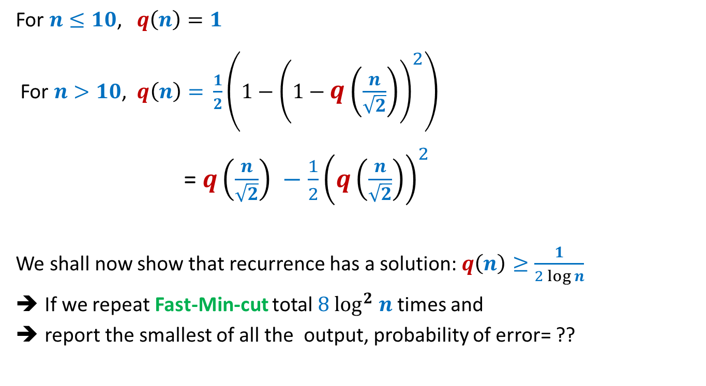
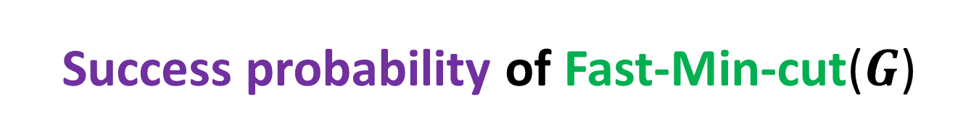

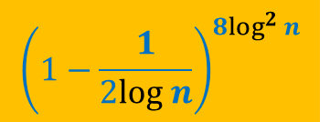
Success probability of Fast-Min-cut($G$)
For $n≤10$, $q\left(n\right)=1$
For $n>10$, $q\left(n\right)=$ $\frac{1}{2}\left(1−{\left(1−q\left(\frac{n}{\sqrt{2}}\right)\right)}^{2}\right)$
= $q\left(\frac{n}{\sqrt{2}}\right) −\frac{1}{2}{\left(q\left(\frac{n}{\sqrt{2}}\right)\right)}^{2}$
We shall now show that recurrence has a solution: $q\left(n\right)≥\frac{1}{2 log n}$
If we repeat Fast-Min-cut total $8 \log^{2} n$ times and
report the smallest of all the output, probability of error= ??
$${\left(1−\frac{1}{2log n}\right)}^{8\log^{2} n}$$
< $n^{−4}$

Slide 24
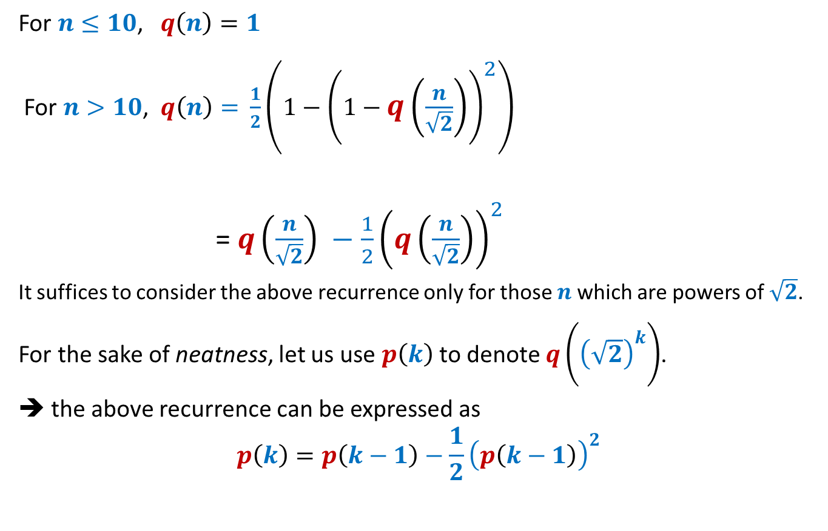
Solving the recurrence
For $n≤10$, $q\left(n\right)=1$
For $n>10$, $q\left(n\right)=$ $\frac{1}{2}\left(1−{\left(1−q\left(\frac{n}{\sqrt{2}}\right)\right)}^{2}\right)$
= $q\left(\frac{n}{\sqrt{2}}\right) −\frac{1}{2}{\left(q\left(\frac{n}{\sqrt{2}}\right)\right)}^{2}$
It suffices to consider the above recurrence only for those $n$which are powers of $\sqrt{2}$.
For the sake of neatness, let us use $p\left(k\right)$to denote $q\left({\left(\sqrt{2}\right)}^{k}\right)$.
➔ the above recurrence can be expressed as
$$p\left(k\right)=p\left(k−1\right)−\frac{1}{2}{\left(p\left(k−1\right)\right)}^{2}$$

Slide 25
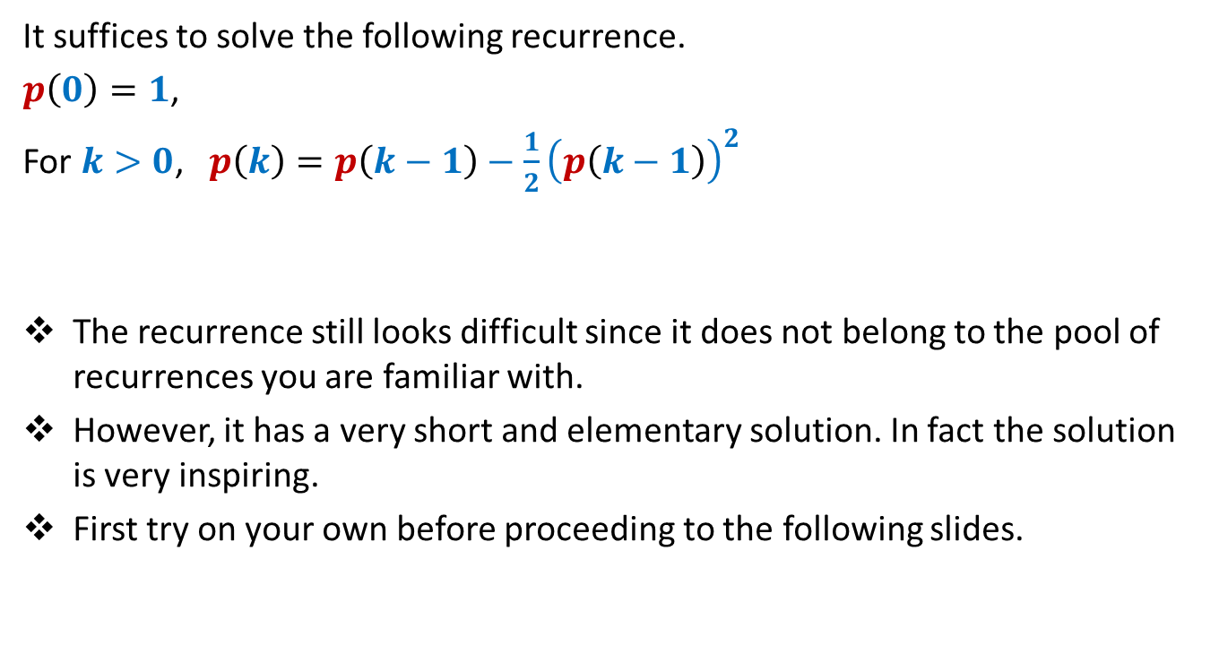
Solving the recurrence
It suffices to solve the following recurrence.
$p\left(0\right)=1$,
For $k>0$, $p\left(k\right)=p\left(k−1\right)−\frac{1}{2}{\left(p\left(k−1\right)\right)}^{2}$
The recurrence still looks difficult since it does not belong to the pool of recurrences you are familiar with.
However, it has a very short and elementary solution. In fact the solution is very inspiring.
First try on your own before proceeding to the following slides.

Slide 26
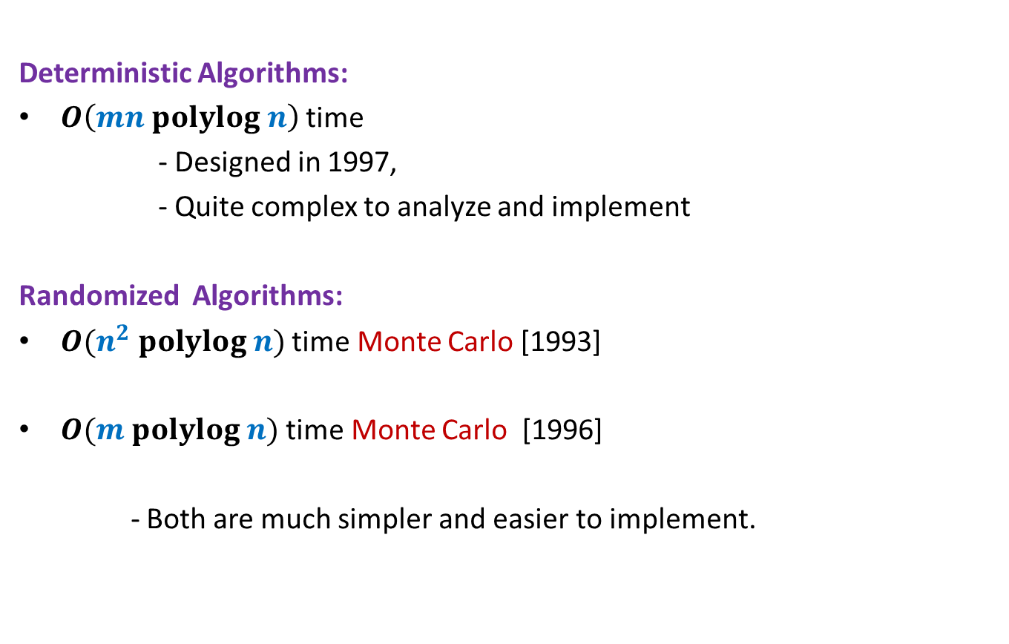
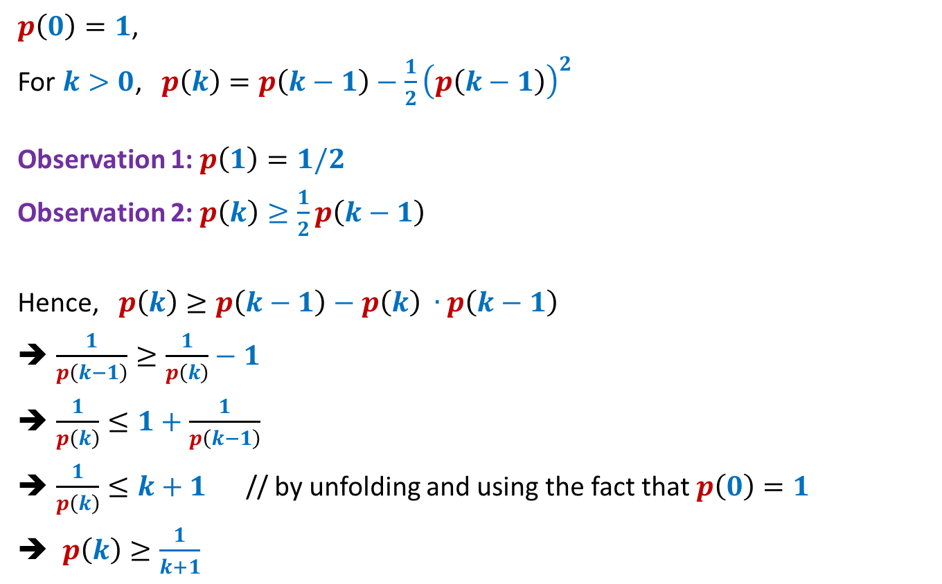
Solving the recurrence
$p\left(0\right)=1$,
For $k>0$, $p\left(k\right)=p\left(k−1\right)−\frac{1}{2}{\left(p\left(k−1\right)\right)}^{2}$
Observation 1: $p\left(1\right)=1/2$
Observation 2: $p\left(k\right)≥\frac{1}{2}p\left(k−1\right)$
Hence, $p\left(k\right)≥p\left(k−1\right)−p\left(k\right) ∙p\left(k−1\right)$
$\frac{1}{p\left(k−1\right)}≥\frac{1}{p\left(k\right)}−1$
$\frac{1}{p\left(k\right)}≤1+\frac{1}{p\left(k−1\right)}$
$\frac{1}{p\left(k\right)}≤k+1$ // by unfolding and using the fact that $p\left(0\right)=1$
$p\left(k\right)≥\frac{1}{k+1}$
proof
$p\left(k\right)=p\left(k−1\right)−\frac{1}{2}{\left(p\left(k−1\right)\right)}^{2}$
$≥p\left(k−1\right)−\frac{1}{2}p\left(k−1\right)$ //since $p\left(k−1\right)≤1$
$=\frac{1}{2}p\left(k−1\right)$

Slide 27


$p\left(k\right)≥\frac{1}{k+1}$
$p\left(k\right)$denotes $q\left({\left(\sqrt{2}\right)}^{k}\right)$.
$q\left(n\right) ≥\frac{1}{2 log n}$
Theorem:
There exists O($n^{2}$ $log^{3} n$) time Monte Carlo algorithm to min-cut
With success probability $≥1−\frac{1}{n^{4}}$
$$n$$

Slide 28
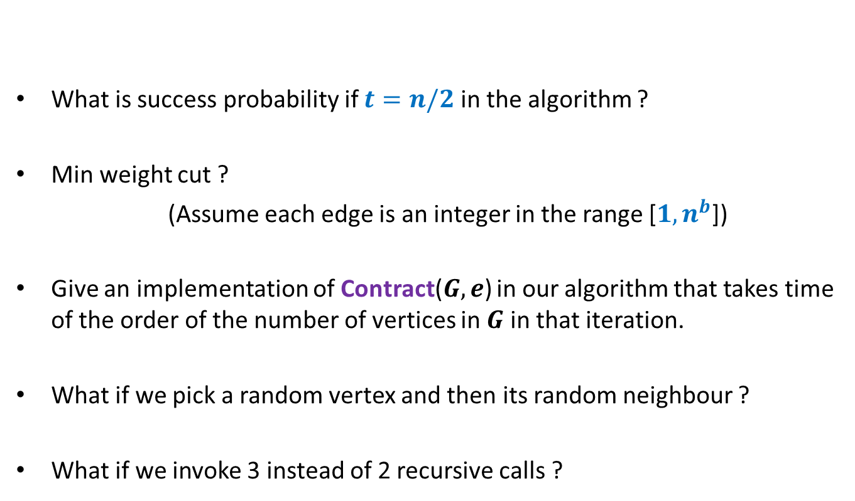
Homework
What is success probability if $t=n/2$ in the algorithm ?
Min weight cut ?
(Assume each edge is an integer in the range [$1,n^{b}$])
Give an implementation of Contract($G,e$) in our algorithm that takes time of the order of the number of vertices in $G$ in that iteration.
What if we pick a random vertex and then its random neighbour ?
What if we invoke 3 instead of 2 recursive calls ?

Slide 29
This algorithm introduced many concepts which can be used for design and analysis of efficient randomized algorithms.
Try to reflect upon these concept…☺

Slide 30
Helping Ram distribute the apple among two friends
Using least no. of random bits.

Slide 31
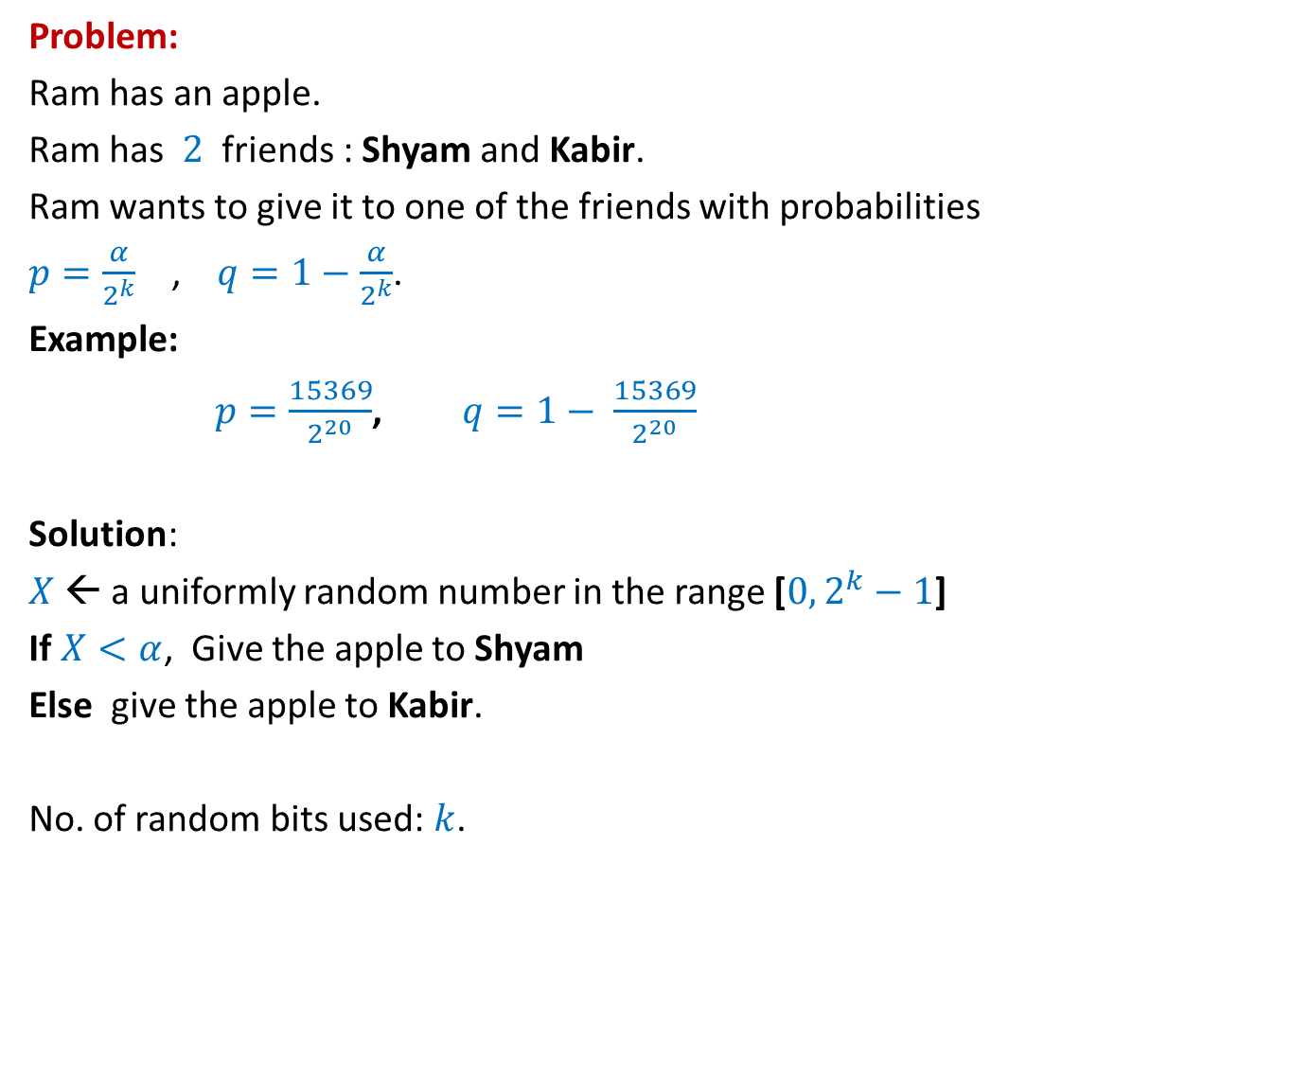
How many random bits ?
Problem:
Ram has an apple.
Ram has $2$ friends : Shyam and Kabir.
Ram wants to give it to one of the friends with probabilities
$p=\frac{α}{2^{k}}$ , $q=1−\frac{α}{2^{k}}$.
Example:
$p=\frac{15369}{2^{20}}$, $q=1− \frac{15369}{2^{20}}$
Solution:
$X$← a uniformly random number in the range [$0,2^{k}−1$]
If $X<α$, Give the apple to Shyam
Else give the apple to Kabir.
No. of random bits used: $k$.
$α$ : any given positive integer $≤2^{k}$
Can we do it in still fewer bits ?
Yes, in expectation ☺

Slide 32
An illustrative example
$$k=2$$
$p=\frac{1}{4}$, and
$1−p=\frac{3}{4}$

Slide 33
How many random bits ?
2-bits Number
$$0 0$$ | Shyam
$$0 1$$ | Kabir
$$1 0$$
$$1 1$$
Let us generate the random bits lazily
,i.e., only when it is absolutely necessary

Slide 34
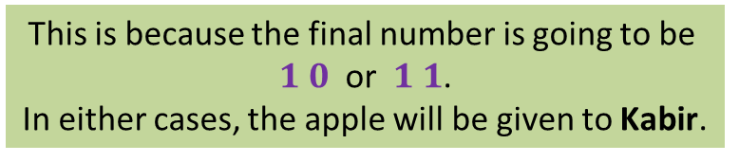
How many random bits ?
No.
2-bits Number
$$0 0$$ | Shyam
$$0 1$$ | Kabir
$$1 0$$
$$1 1$$
This is because the final number is going to be
$1 0$ or $1 1$.
In either cases, the apple will be given to Kabir.
$$1$$
Revealed
If the MSB is $1$,
do we need other bits of the number ?
Let us generate the MSB (Most Significant Bit) first.

Slide 35

How many random bits ?
Yes.
2-bits Number
$$0 0$$ | Shyam
$$0 1$$
$$1 0$$
$$1 1$$
$X$ : the number of random bits needed.
E[$X$] = $\frac{1}{2}⋅$ E[$X$| MSB is $1$] + $\frac{1}{2}⋅$ E[$X$| MSB is $0$]
= $\frac{1}{2}⋅1+\frac{1}{2}⋅2$ = $\frac{3}{2}⋅$
This is because the final number is going to be
$0 0$ (Shyam)
or $0 1$ (Kabir).
Revealed
$$0$$
But now the problem becomes simpler. Can you see ?
Kabir
If the MSB is $0$,
do we need other bits of the number ?
It is now like the case of $k=1$ now.
$$1$$
$1+$ No. of bits to distribute with $p=\frac{1}{2}$
$$2$$
That is, distributing with $p=\frac{1}{2}$ .

Slide 36
An illustrative example
$$k=3$$
$p=\frac{5}{8}$, and
$1−p=\frac{3}{8}$

Slide 37
How many random bits ?
3-bits Number
$$0 0 0$$ | Shyam
$$0 0 1$$
$$0 1 0$$
$$0 1 1$$
$$1 0 0$$
$$1 0 1$$ | Kabir
$$1 1 0$$
$$1 1 1$$
Let us generate the random bits lazily
,i.e., only when it is absolutely necessary

Slide 38
How many random bits ?
No.
3-bits Number
$$0 0 0$$ | Shyam
$$0 0 1$$
$$0 1 0$$
$$0 1 1$$
$$1 0 0$$
$$1 0 1$$ | Kabir
$$1 1 0$$
$$1 1 1$$
This is because the final number is going to be
$0 0 0$ or $0 0 1$ or $0 1 0$ or $0 1 1$
In these cases, the apple will be given to Shyam.
$$0$$
Revealed
If the MSB is $0$,
do we need other bits of the number ?
Let us generate the MSB (Most Significant Bit) first.

Slide 39
How many random bits ?
Yes.
3-bits Number
$$0 0 0$$
$$0 0 1$$
$$0 1 0$$
$$0 1 1$$
$$1 0 0$$
$$1 0 1$$ | Kabir
$$1 1 0$$
$$1 1 1$$
This is because the final number is going to be
$1 0 0$ (Shyam)
or $1 0 1$ or $1 1 0$ or $1 1 1$ (Kabir).
$$1$$
Shyam
2-bits Number
But now the problem becomes simpler. Can you see ?
If the MSB is $1$,
do we need other bits of the number ?
Revealed
It is now like the case of $k=2$ now.
That is, distributing with $p=\frac{1}{4}$ .
Let us generate the MSB (Most Significant Bit) first.

Slide 40


$X$ : the number of random bits needed.
E[$X$] = $\frac{1}{2}⋅$ E[$X$| MSB is $0$] + $\frac{1}{2}⋅$ E[$X$| MSB is $1$]
= $\frac{1}{2}⋅1+\frac{1}{2}⋅\frac{5}{2}$
= $\frac{7}{4}⋅$
$$1$$
$1+$ Expected no. of bits to distribute with $p=\frac{1}{4}$
$$1+\frac{3}{2}$$

Slide 41
The generic example
$p=\frac{α}{2^{k}}$ , $1−p=\frac{2^{k}−α}{2^{k}}$

Slide 42



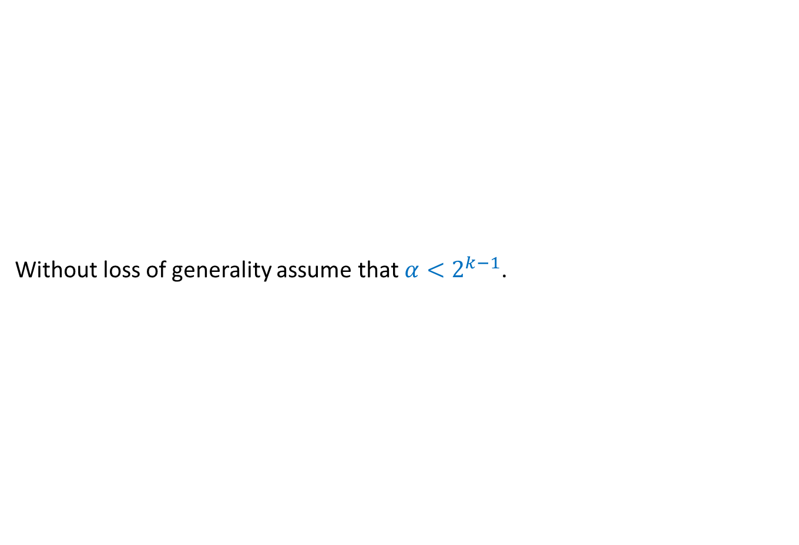




How many random bits ?
Not needed
Without loss of generality assume that $α<2^{k−1}$.
$$1$$ | $$1$$ | $$0$$ | $$1$$ | $$0$$ | $$0$$ | $$0$$ | $$1$$
$$1 2 … k$$
Shyam
Kabir
$$0$$
$$α−1$$
$$2^{k−1}−1$$
$$2^{k}−1$$
$$0 0 0…0$$
$$0 1 1…1$$
$$1 1 1…1$$
$k0$’s
$(k−1)1$’s
$$k{ 1}^{′}s$$
If the Most Significant Bit is $1$,
do we need other bits of the number ?
Suppose a random $k$-bit number is generated.

Slide 43





How many random bits ?
B($α,k$) : Expected number of bits to divide with parameters $p=\frac{α}{2^{k}}$
B($α, k$) = $1 + \frac{1}{2}⋅0 +\frac{1}{2}⋅$
= $1+\frac{1}{2}⋅$ B($α,k−1$)
$$0$$
$$1 2 … k$$
$$0$$
$$α−1$$
$$2^{k−1}−1$$
$$0 0 0…0$$
$$0 1 1…1$$
$$1 1 1…1$$
$$k−1$$
$$k$$
If the Most Significant Bit is $0$,
do we need other bits of the number ?
B($α,k−1$)
Yes, indeed.
$$<2$$
But problem now reduces to a smaller problem.
Think over it before pressing next button...

Slide 44

Computing a random sample of size $k$from [$0,n−1$]
In an efficient manner.

Slide 45


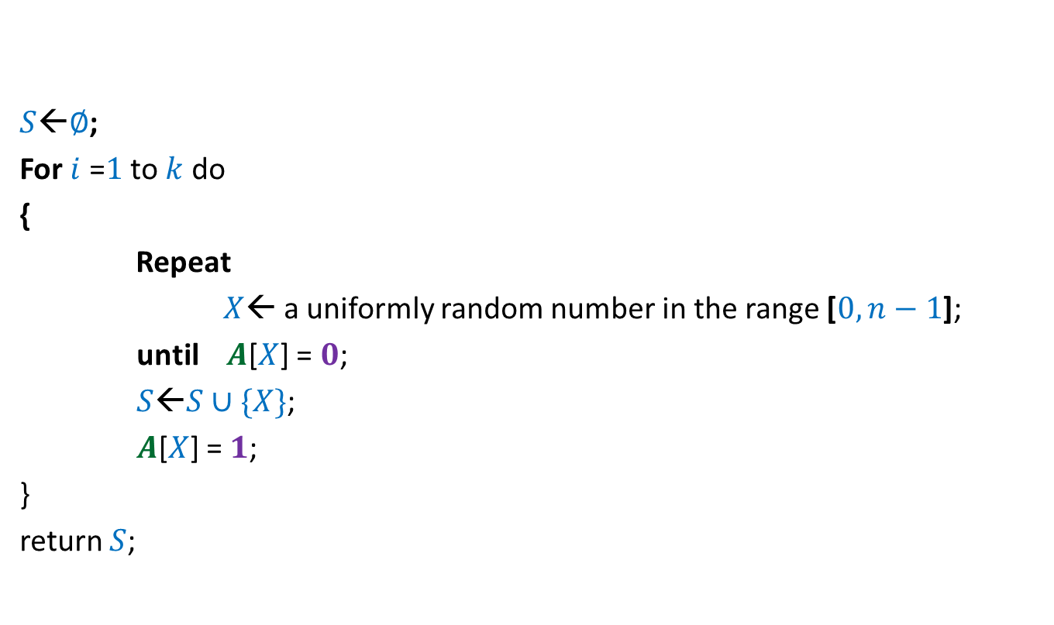


$$0$$ | $$0$$ | $$0$$ | $$0$$ | $$0$$ | $$0$$ | $$0$$ | $$0$$
$$A$$
$$1$$
$$1$$
$$1$$
$$1$$
$S$←$∅$;
For $i$ =$1$ to $k$ do
{
Repeat
$X$← a uniformly random number in the range [$0,n−1$];
until $A$[$X$] = $0$;
$S$←$S∪\{X\}$;
$A$[$X$] = $1$;
}
return $S$;
$$0 1 … n−1$$
Homework: Prove that the algorithm indeed computes a uniformly random sample.

Slide 46

Computing a random permutation of [$0,n−1$]
In an efficient manner.

Slide 47

$$0$$ | $$0$$ | $$0$$ | $$0$$ | $$0$$ | $$0$$ | $$0$$ | $$0$$
$$A$$
$$1$$
$$1$$
$$1$$
$$1$$
$$1$$
$$1$$
$S$←empty string;
For $i$ =$1$ to $n$ do
{
Repeat
$X$← a uniformly random number in the range [$0,n−1$];
until $A$[$X$] = $0$;
$S$←$S∷X$;
$A$[$X$] = $1$;
}
return $S$;
$$0 1 … n−1$$
What is the expected no. of calls to “random number generator” this algorithm makes ?
Homework: Prove that the algorithm indeed computes a uniformly random permutation.

